Slide 1
Practical Deep Learning

Slide 2
Introduction
Practical Implementation of Deep Learning algorithms is just as much an art as it is a science.
The main take aways if not to start from scratch rather to build on top of the previous knowledge.
Today, we will look at some important tools used in the practical implementation of Deep Learning algorithms.

Slide 3
Outline
Data Handling
Data Augmentation
Transfer Learning
Ensembling
Batch Normalization

Slide 4
Data Handling
As we have previously established that Deep Learning has been made possible by large amount of data and computational resourse
An important aspect to keep in mind is the data handling:
How do we handle large amounts of data?
How to we read different components of data (from possible different parts of our hard drive) and provide it to our training algorithms?
How do we feed this data to SGD algorthims in a streamlined manner?
PyTorch provides Dataset and DataLoaders to handle data in an efficient manner.
We will extend the Dataset and DataLoaders class to construct our own Dataloaders

Slide 5
DataLoaders
Batch 1
D_4
D_1
D_a
Hard Drive
Dataset
Batch 2
D_1
X_1, y_1
D_9
D_6
D_b
X_1
y_1
Dataset
D_2
X_2, y_2
DataLoader
y_3
X_2
D_3
X_3, y_3
y_2
X_3
Batch k
X_N
y_N
D_N
X_N, y_N
D_3
D_8
D_z

Slide 6
Data Augmentation
Data is the fundamental building block of any machine learning algorithm
In several applications we don’t have access to unlimited data
So we use Data Augmentation techniques to improve the preformance of our models
Note: It is better to spend time on data rather than fine-scale architecture search in deep learning

Slide 7
Data Augmentation
Create virtual training samples
Horizontal flip
Random crop
Color casting
Geometric distortion
Translation
Rotation

Slide 8
Transfer Learning
Improvement of learning in a new task through the transfer of knowledge from a related task that has already been learned.
We will look at one strategy of transfer learning called Fine-Tuning

Slide 9
When to fine-tune your model?
New dataset is small with distribution similar to original dataset.
Keep the feature extraction part fixed and fine-tune the classifier part of the network
New dataset is large with similar distribution to the original dataset
Fine tune both the feature extractor and the classifier part of the network
New dataset is small but different distribution from the original dataset
Use SVM classifier on the features extracted from the feature extractor part of the Network
New dataset is large and different distribution from the original dataset
Fine tune both the feature extractor and the classifier part of the network

Slide 10
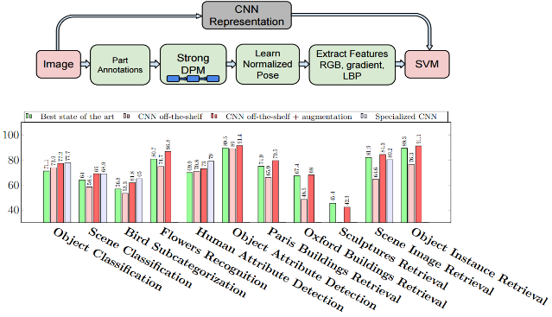
CNN Features off-the-shelf: an Astounding Baseline for Recognition [Razavian et al. 2014]

Slide 11
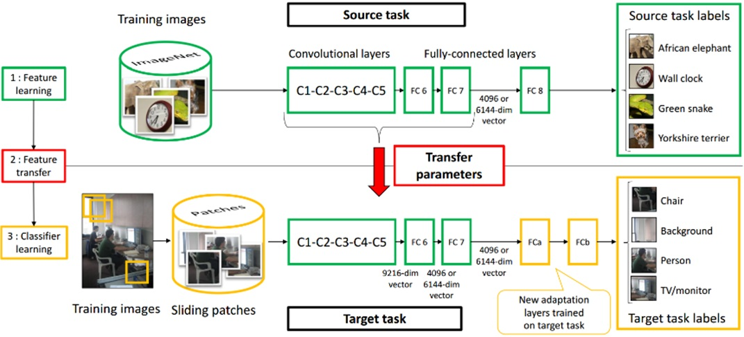
Learning and Transferring Mid-Level Image Representations using Convolutional Neural Networks [Oquab et al. CVPR 2014]

Slide 12
Ensembling
Team-work is the best policy
Multiple networks for the same task
Max Voting for final classification

Slide 13
Ensembling: A simple analysis
Let’s assume that we have a test dataset with N elements and an ensemble of M models.
Also assume that the probability of error of the label for an image on a model in the ensemble is dentoted by p(e) and is i.i.d
For an example assume M=3 and e =0.01
Then probability of error of label for the max voting ensemble will be
For the above example p(e)=0.0003, which is significantly lower than a single model

Slide 14
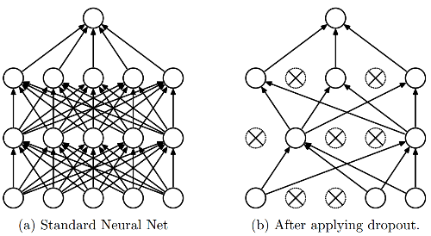
Dropout
Intuition: successful conspiracies
50 people planning a conspiracy
Strategy A: plan a big conspiracy involving 50 people
Likely to fail. 50 people need to play their parts correctly.
Strategy B: plan 10 conspiracies each involving 5 people
Likely to succeed!
Dropout: A simple way to prevent neural networks from overfitting [Srivastava JMLR 2014]

Slide 15
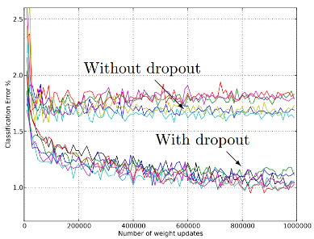
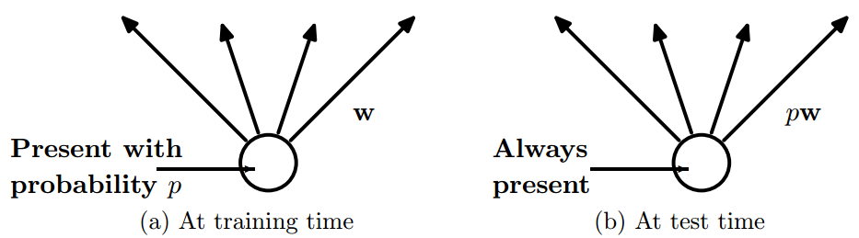
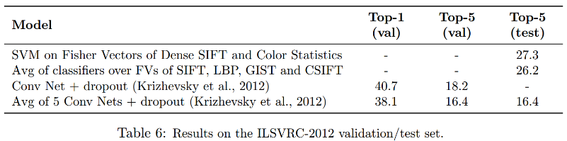
Dropout
Main Idea: approximately combining exponentially many different neural network architectures efficiently
Dropout: A simple way to prevent neural networks from overfitting [Srivastava JMLR 2014]

Slide 16
Batch Normalization
Very useful for training deep networks
Standardizes input of each layer for a mini-batch
Results in speed up of training
For more detail, refer to the paper: Batch Normalization: Accelerating Deep Network Training by Reducing Internal Covariate Shift, 2015

Slide 17
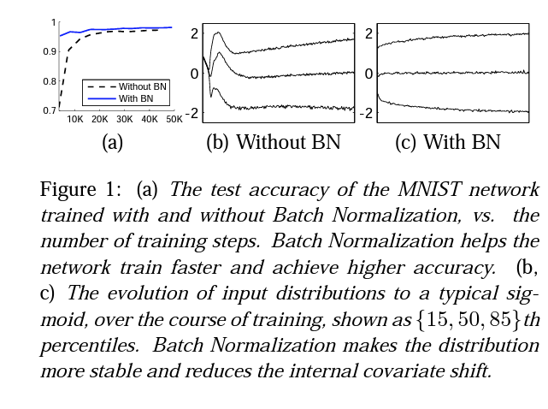
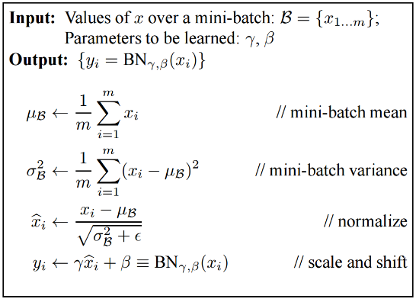
Batch Normalization
Batch Normalization: Accelerating Deep Network Training by Reducing Internal Covariate Shift [Ioffe and Szegedy 2015]

Slide 18
Things to remember
Training Deep Networks Dropout
Data augmentation
Activation
Batch normalization
Transfer learning
Use Fine-tuning when possible

Slide 19
Full Deep learning Pipeline
Data Pre-processing
Architecture
Loss
Optimizer
DataLoaders
Data Augmentation
Fine-Tuning
Ensembling

